Slide 1

Used Car Price Prediction Using Machine Learning Techniques
Submitted by:
Prassanth E
Ann Maria John
Pratik Asarkar
Priyanka Parlikar
Rudra Pratap Sen
Mentor: Mr. Srikar Muppidi
Batch: DSE DEC 2019, Bangalore

Slide 2
Problem Statement
Need for a used car price prediction system: To effectively determine the worthiness of a used car using a variety of features.
Target Business: Online Used-car dealers
Target Customers: Buyers who would like to purchase used cars via online portal

Slide 3
Data Dictionary
Numerical Features
Feature Name | Feature Description | Min. | Max. | Std. Deviation
Price | The price on the ad to sell the car | 0 | 2147484000 | 3587954
Year of Registration | Year in which the car was first registered | 1000 | 9999 | 92.866598
Power (PS) | Power of the car in PS | 0 | 20000 | 192.139578
Kilometer | How many kilometers the car has driven | 5000 | 150000 | 40112.337051
Month of Registration | At which month the car was first registered | 0 | 12 | 3.712412
No. of pictures | Number of pictures in the ad | 0 | 0 | 0
Postal code | Postal code of the city where the car is available. | 1067 | 99998 | 25799.08247

Slide 4
Data Dictionary
Categorical Features
Feature Name | Feature Description | Number of Categorical Values
Name | Name of the car | 233531
Seller | Private or dealer | 2
Offer type | Offer or Application | 2
A/B Test | Test or Control | 2
Vehicle type | Describes the type of Vehicle | 8
Gearbox | Whether the car has manual or automatic gearbox | 2
Model | The model of a car is the name used by a manufacturer to market a range of similar cars | 251
Fuel type | The Fuel system on which the car runs | 7
Brand | The Brand which the car belongs to | 40
Not repaired damage | If the car has a damage which is not repaired yet | 2

Slide 5
Data Dictionary
Date-Time Features
Feature Name | Feature Description | Unique Values | First Value | Last Value
Date crawled | When this ad was first crawled, all field-values are taken from this date | 280500 | 2016-03-05 | 2016-04-07
Date created | The date for which the ad at EBay was created | 114 | 2014-03-10 | 2016-04-07
Last seen online | When the crawler saw this ad last online | 182806 | 2016-03-05 | 2016-04-07

Slide 6
Data Cleaning
OUTLIER TREATMENT
Isolation forest anomaly detection technique
Capped outliers – outlier values seemed practically impossible
Price
Range considered: 100 to 100,000 euro
PowerPS
Range considered: 40 to 800 PS

Slide 7
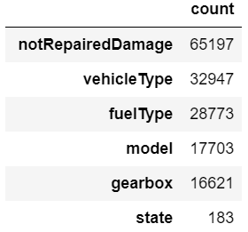
Data Cleaning
MISSING VALUE IMPUTATION
Dropped features
notRepairedDamage, fuelType, model, gearbox and state quite independent of any other features in the dataset imputing these would result in an increase in multicollinearity between independent features
huge dataset at our disposal, hence, losing some data would not cost much, as far as information loss is concerned.
KNN imputation
vehicleType : KNN imputation using model, brand and price

Slide 8
Data Cleaning
FEATURE SELECTION
Dropped features based on Statistical Tests : abtest
Imbalanced features : seller, offerType
Redundant features : dateCrawled, noOfpictures
FEATURE EXTRACTION
ageOfVehicle : yearOfRegistration and monthOfRegistration
No_of_days_online : dateCreated and lastSeen
State : postalCode
CountryOfManufacture : brand

Slide 9
Data Cleaning
FEATURE ENGINEERING
Low cardinality features
One Hot Encoding
High cardinality features
Count, Frequency, Mean, K-Fold Target, One Hot Encoding
Best RMSE scores : combination of OHE and k-fold target encoding technique used

Slide 10
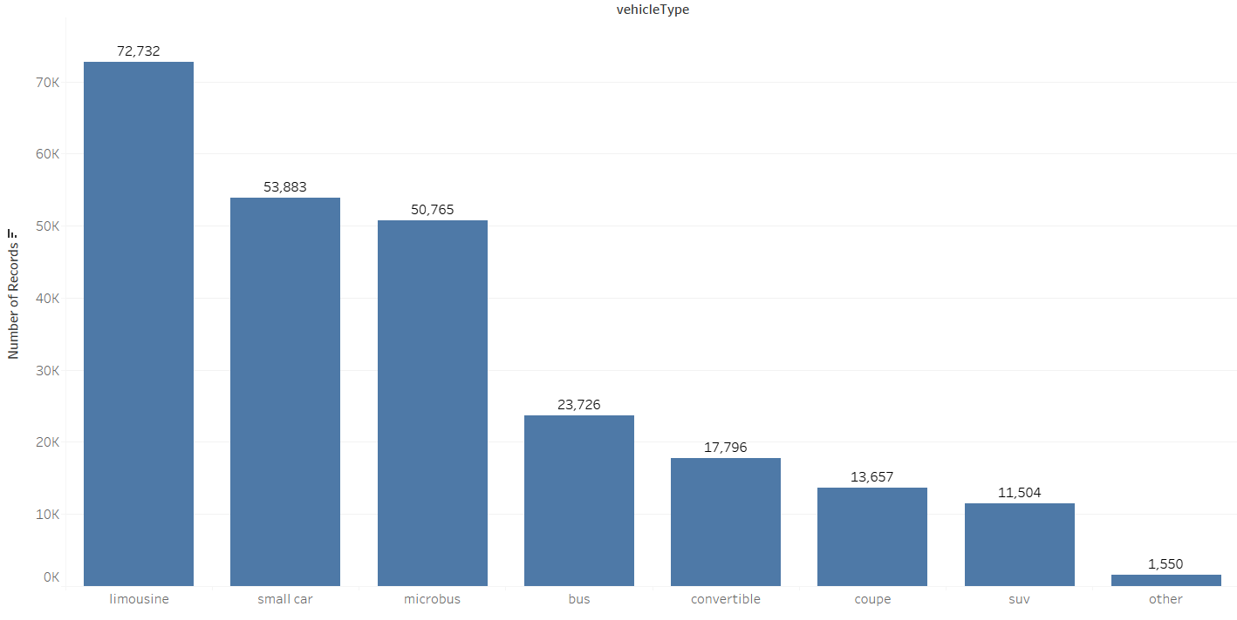
Exploratory Data Analysis – Univariate Analysis
Count of vehicleType
Limousine, small car and microbus are the most used vehicle type.
Brands like BMW and Mercedes Benz sedan cars are used as taxi in Germany.

Slide 11
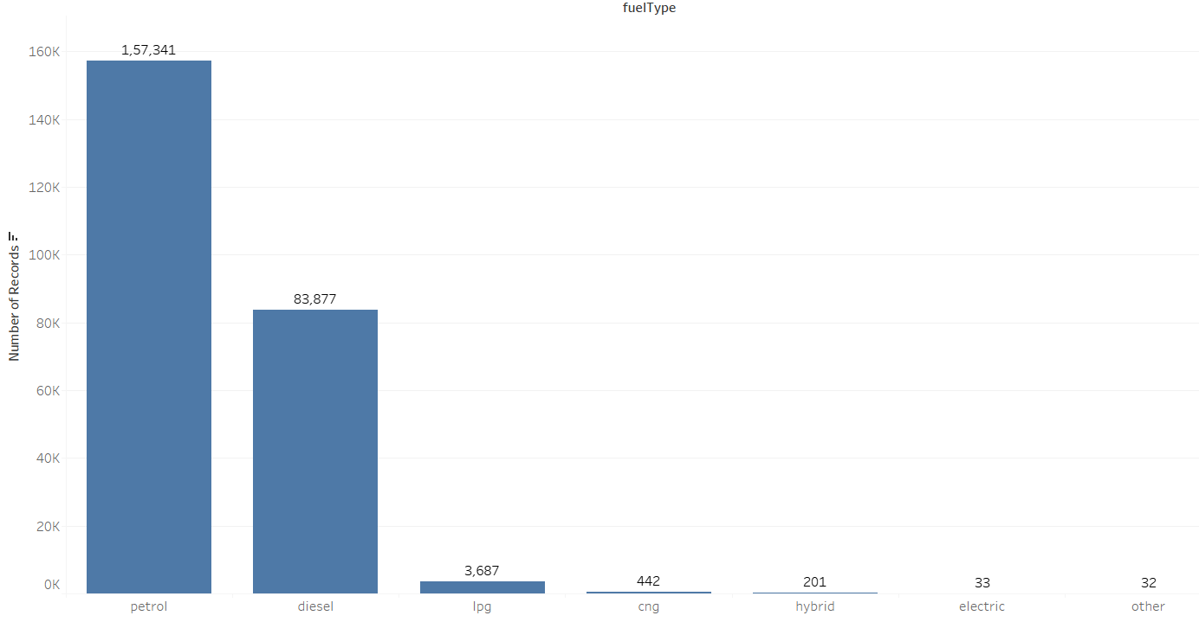
Exploratory Data Analysis – Univariate Analysis
Count of fuelType
Petrol and Diesel cars are most in demand

Slide 12
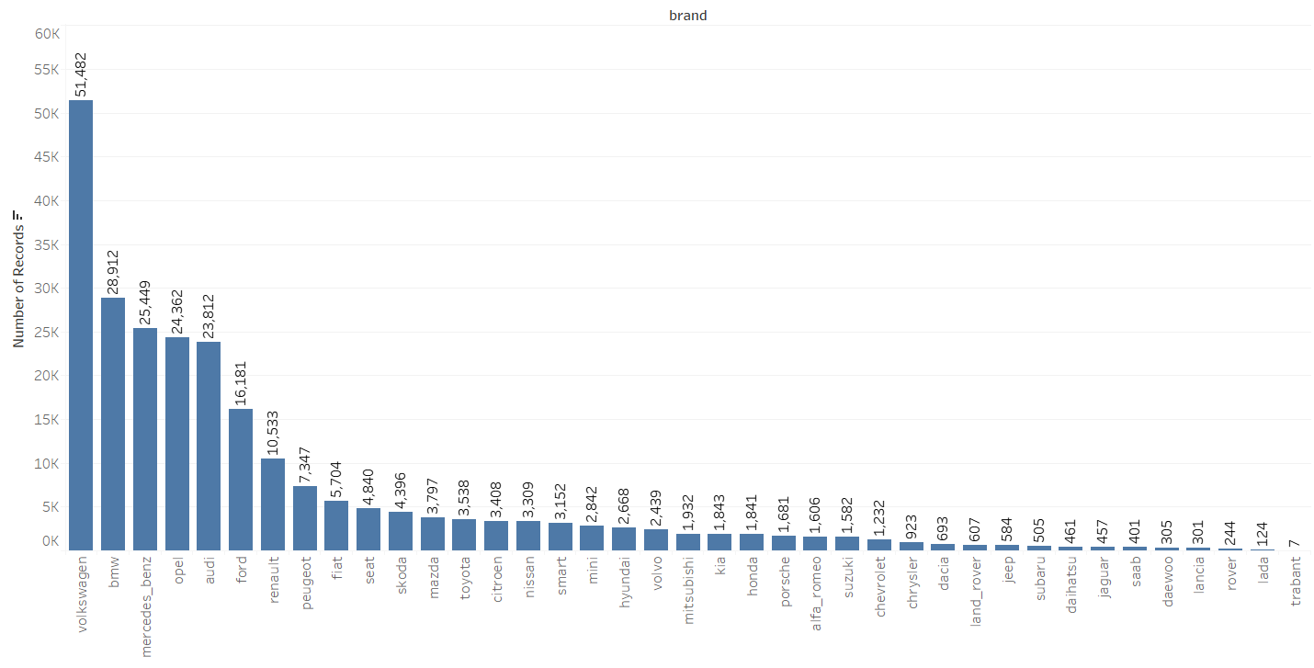
Exploratory Data Analysis – Univariate Analysis
Count of brand: Volkswagen, BMW, Mercedes Benz, Opel and Audi are the top most brands available in used car segment.

Slide 13
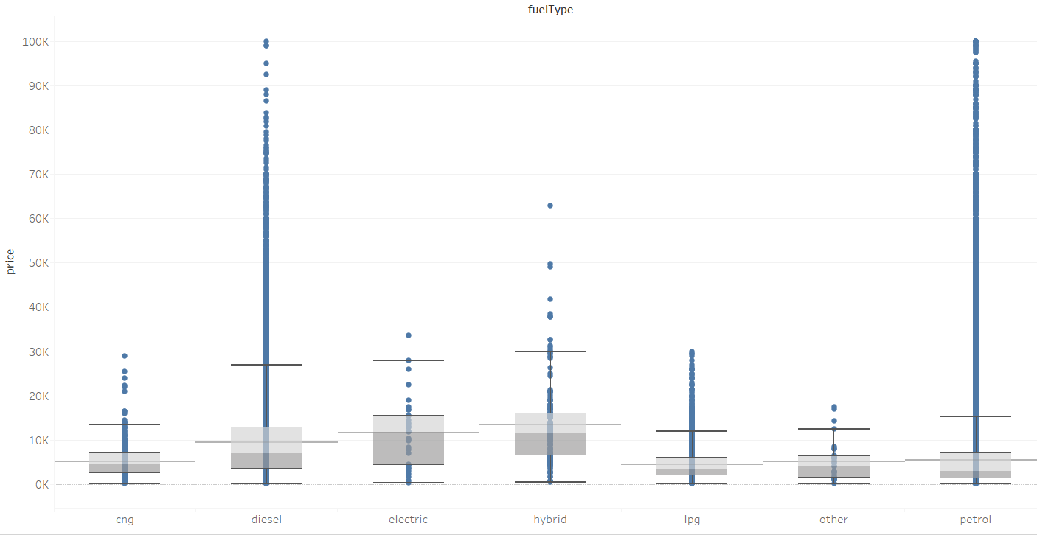
Exploratory Data Analysis – Bivariate Analysis
Price v/s fuelType
Cars of electric and hybrid fuel type are expensive as compared to other fuel types.
Diesel and petrol fuel type cars belong to moderate range of price.
CNG and LPG cars are the least expensive.

Slide 14
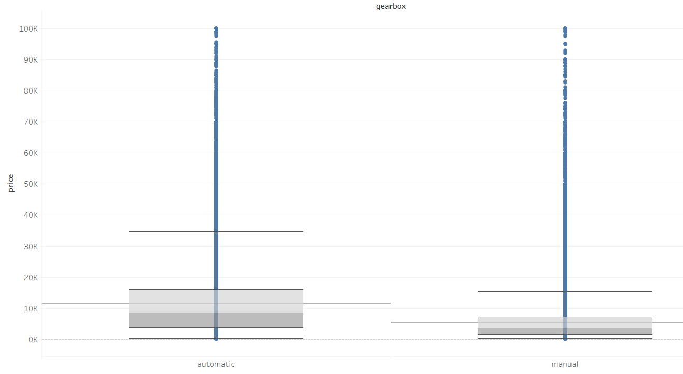
Exploratory Data Analysis – Bivariate Analysis
Price v/s gearbox
Cars with automatic gearbox are of higher prices as compared to cars with manual gearbox.

Slide 15
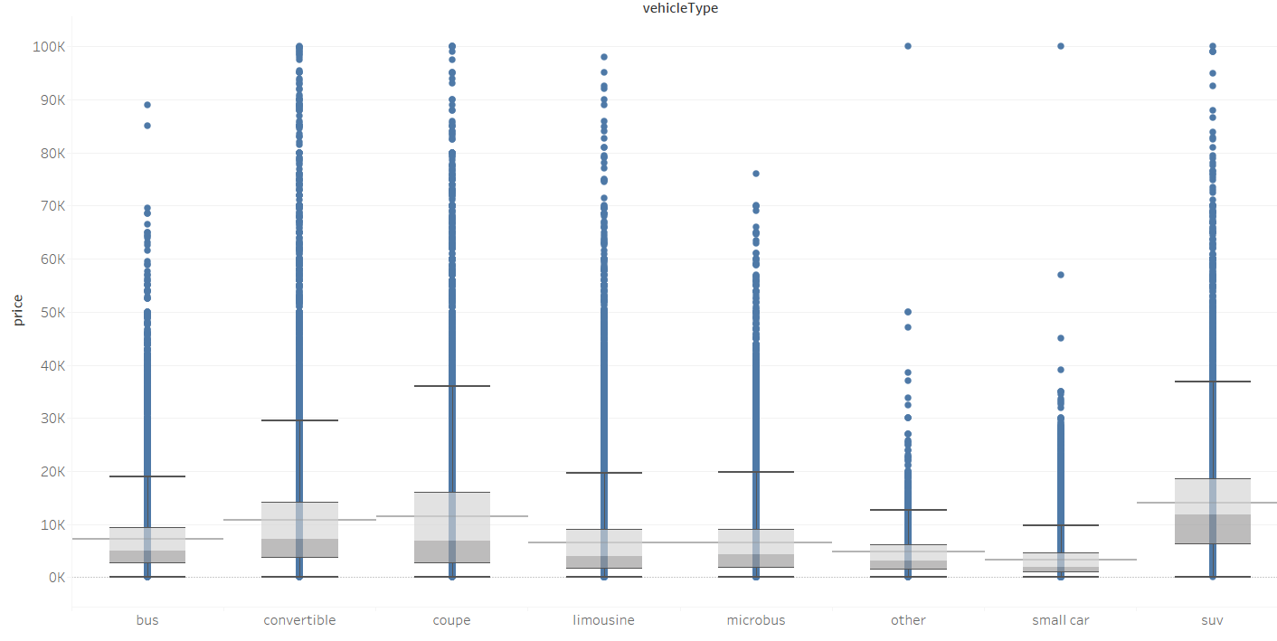
Exploratory Data Analysis – Bivariate Analysis
Price v/s vehicleType
SUV, coupe and convertible vehicle types comes under higher price ranges.
The mean price difference between convertible and coupe; limousine and microbus is less.

Slide 16
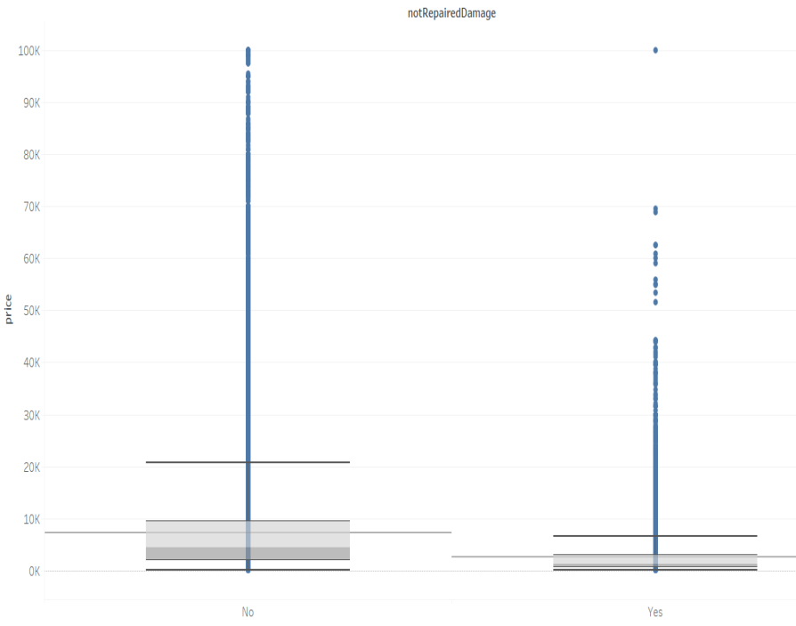
Exploratory Data Analysis – Bivariate Analysis
Price v/s notRepairedDamage
Cars that do not have unrepaired damages have higher prices compared to the ones that have not repaired damages.

Slide 17
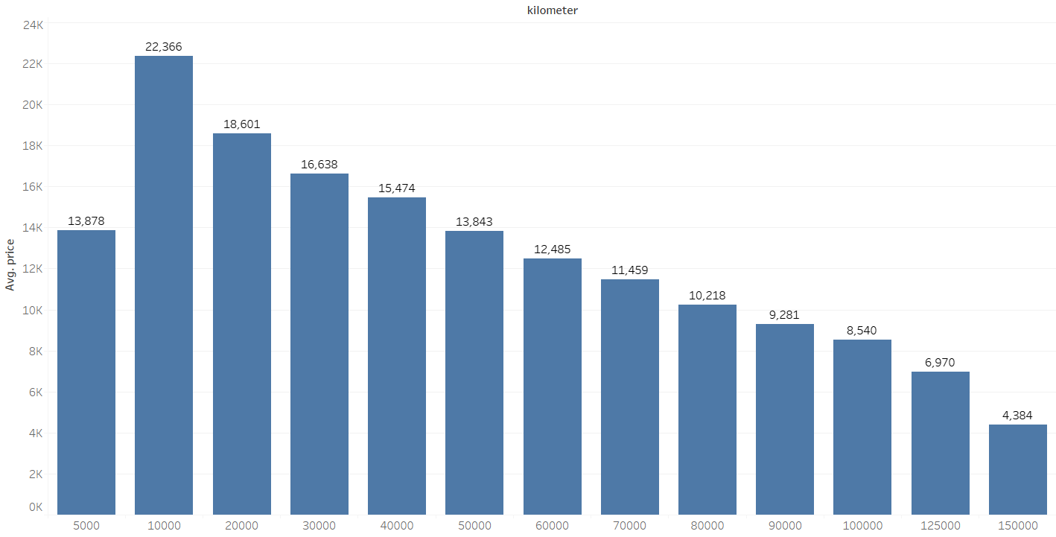
Exploratory Data Analysis – Bivariate Analysis
Average Price v/s Kilometer
As the kilometers driven increases, average price decreases, this could probably mean that customers are keen on buying used cars that are less driven and are relatively in good condition.

Slide 18
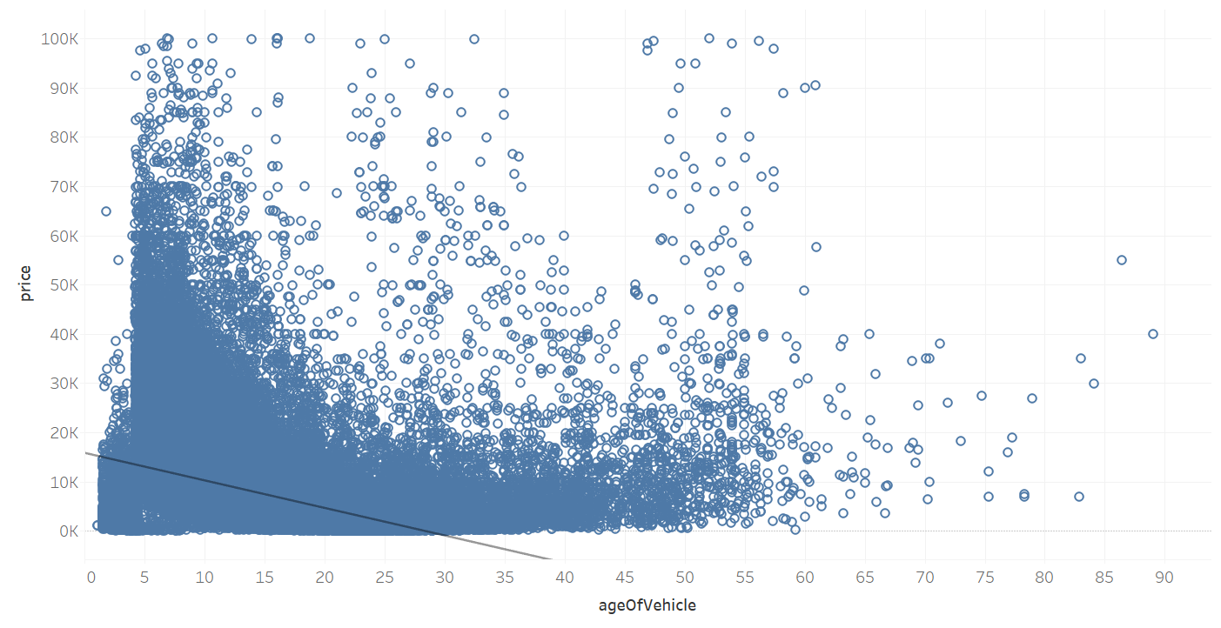
Exploratory Data Analysis – Bivariate Analysis
Price v/s ageOfVehicle
The trend line in the above scatter plot indicates a strong negative correlation between price and age of vehicle.

Slide 19
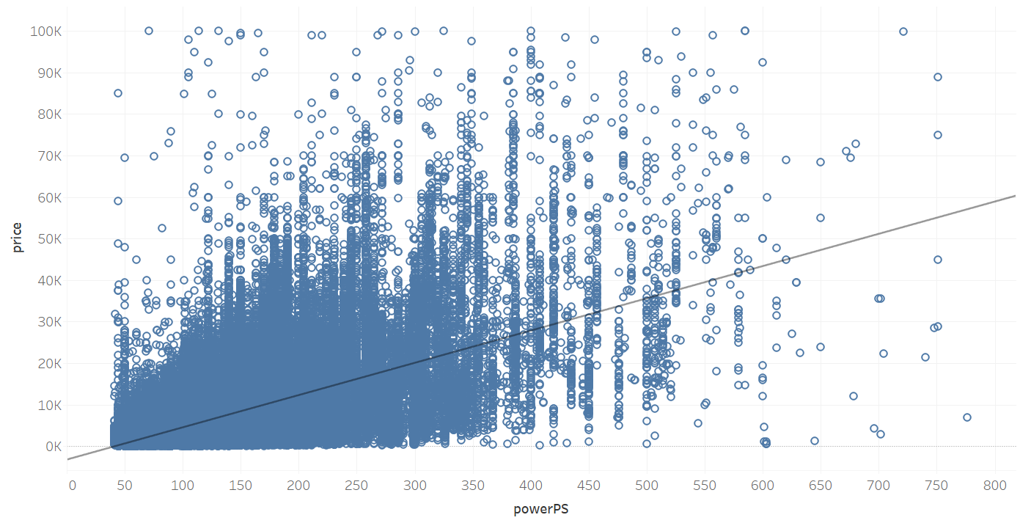
Exploratory Data Analysis – Bivariate Analysis
Price v/s PowerPs
The above trend line shows a positive correlation between price and powerPS.

Slide 20
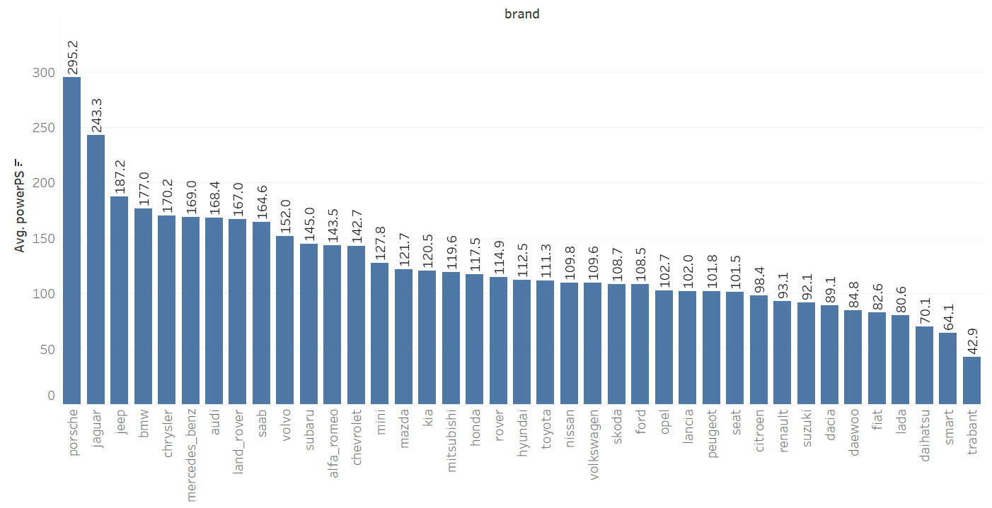
Exploratory Data Analysis – Bivariate Analysis
Average powerPS v/s brand: Porsche, land rover and jaguar top the brand list being the most expensive used cars.

Slide 21
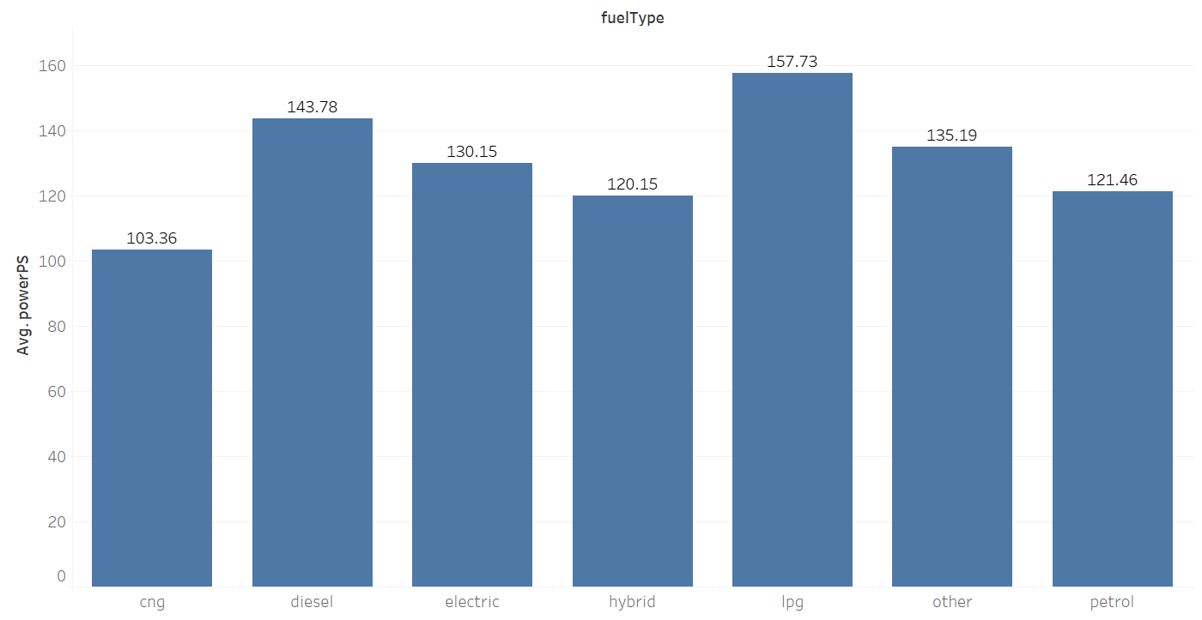
Exploratory Data Analysis – Bivariate Analysis
Average powerPS and fuelType
As Germany is more likely to ban diesel and petrol cars in the country by 2030, LPG and electric cars seems to be an efficient alternative in terms of powerPS performance.
Diesel cars with automatic gearbox gives 2nd best average powerPS hugely comes within higher price ranges could be mainly sport cars.

Slide 22
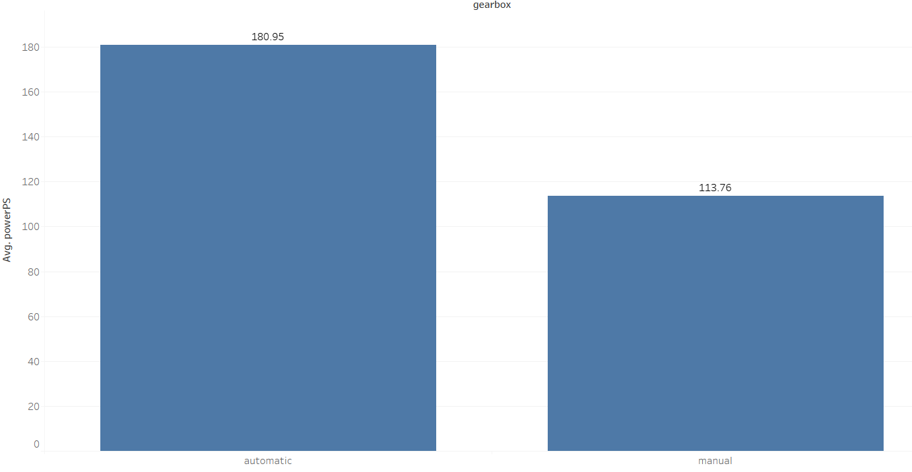
Exploratory Data Analysis – Bivariate Analysis
Average powerPS and gearbox
Cars with low power generally have manual gearbox.
Mid-range cars will have an equal number of manual and automatic gearboxes.

Slide 23
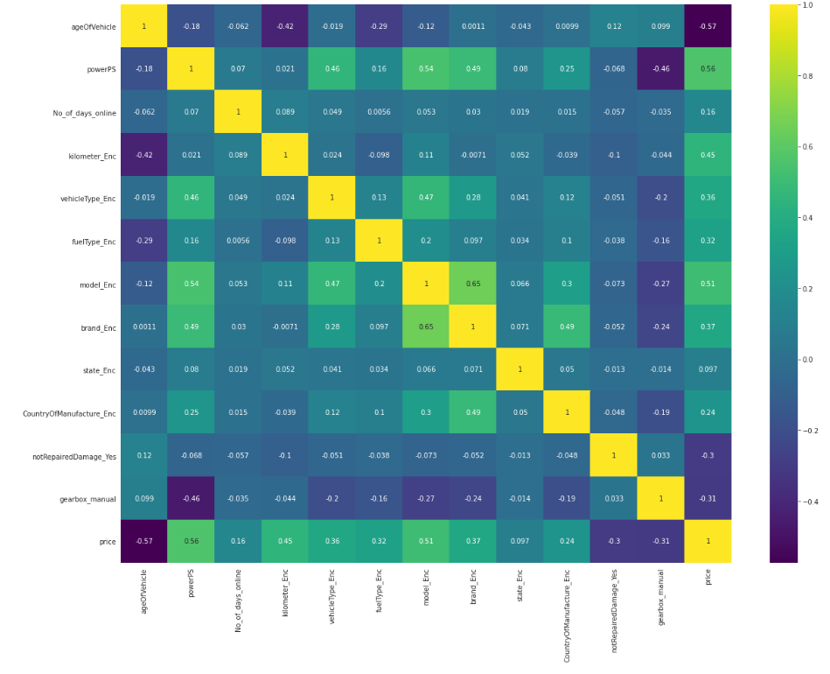
Exploratory Data Analysis – Multivariate Analysis

Slide 24
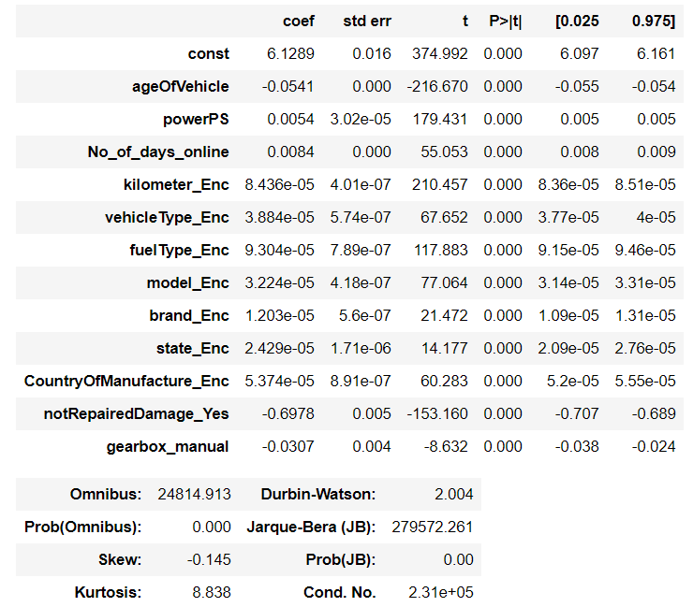
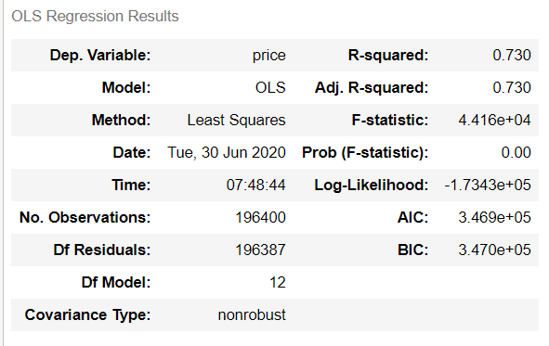
Base Line Model

Slide 25
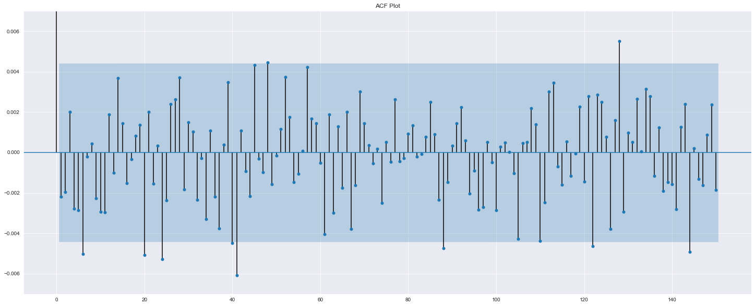
Assumptions of Linear Regression
1. No Auto Correlation
Durbin-Watson test value : 2.004
ACF plot

Slide 26
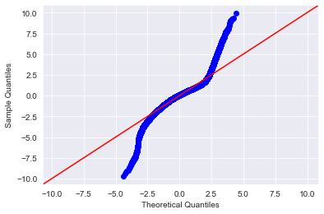
Assumptions of Linear Regression
2. Normality of Residuals
The Jarque Bera test resulted in a p-value of 0.0 along with a test statistic value of 279727.82 which is greater than the t-critical value of 5.99.

Slide 27
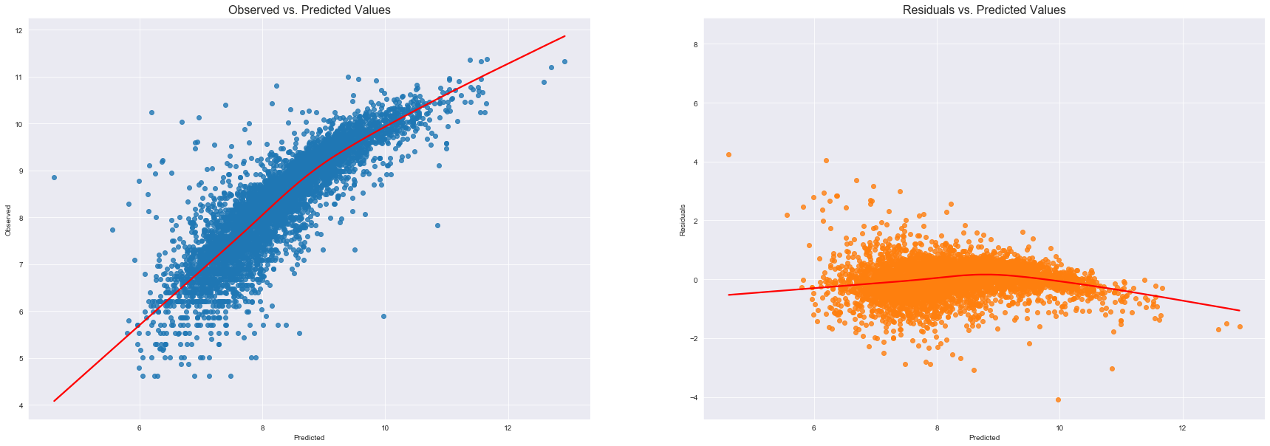
Assumptions of Linear Regression
3. Linearity of Residuals
P-value of 0.377 for Linear Rainbow test which is higher than 0.05.

Slide 28
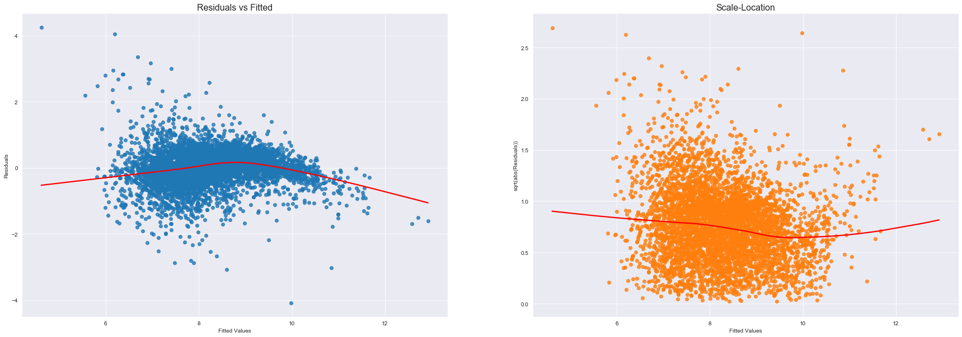
Assumptions of Linear Regression
4. Homoscedasticity
The Goldfeld-Quandt test gives a p-value of 0.3132 which is higher than 0.05.

Slide 29
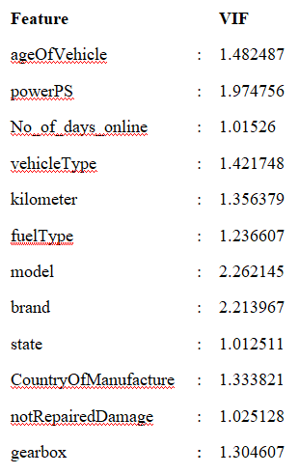
Assumptions of Linear Regression
5. No multicollinearity
Values of more than 4 or 5 are regarded as being moderate to high, with values of 10 or more being regarded as very high.

Slide 30
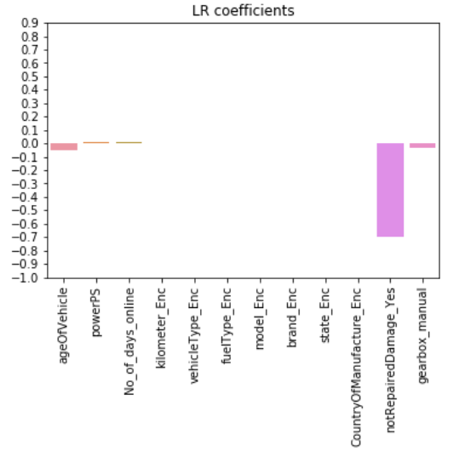
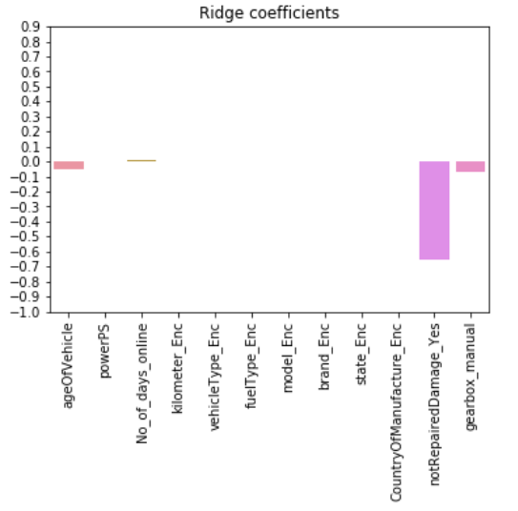
Parametric Models
Linear Regression, Ridge Regression, Lasso Regression and Elastic Net Regression
Coefficients for parametric models – Linear Regression, Ridge Regression

Slide 31
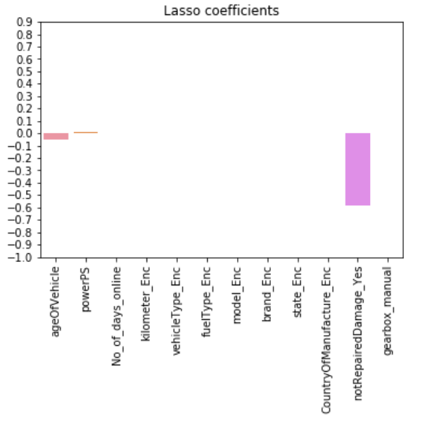
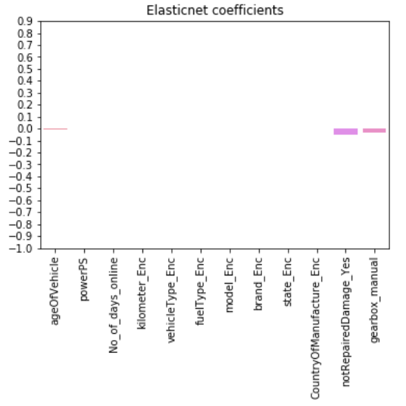
Parametric Models
Coefficients for parametric models – Lasso Regression, ElasticNet Regression

Slide 32
Parametric Models
Bias and Variance errors for various parametric models
Machine Learning Method | Bias Error | Variance Error
Linear Regression | 0.586 | 0.0065
Ridge Regression | 0.588 | 0.0062
Lasso Regression | 0.596 | 0.0061
Elastic Net Regression | 1.047 | 0.0070

Slide 33
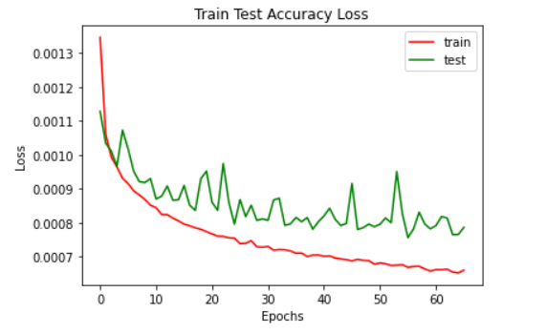
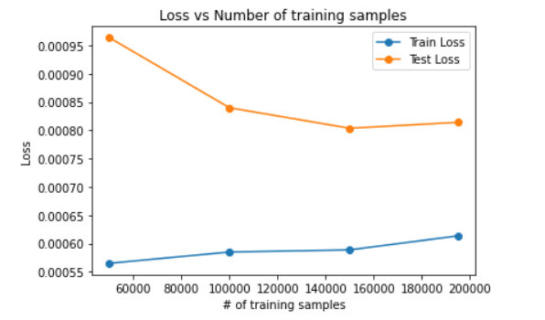
Artificial Neural Network
Mean RMSE score for neural network model is around 2839.18 with the deviation of 45.8 euros.

Slide 34
Non- Parametric Models
DT Regressor
DT Bagging Regressor
DT Adaboost Regressor
RF Regressor
RF Adaboost Regressor
KNN Regressor
KNN Bagging Regressor
Gradient Boost Regressor

Slide 35
Non- Parametric Models
Machine Learning Method | Bias Error | Variance Error | Coefficient of determination
DT | 3166.6566 | 20.6882 | 0.8449
DT Bagged | 3048.6105 | 22.8342 | 0.8563
DT Boosted | 2920.2432 | 84.4988 | 0.8681
KNN | 2902.0643 | 21.2644 | 0.8698
KNN Bagged | 2968.2142 | 12.0855 | 0.8638
RF | 2874.4468 | 44.6939 | 0.8721
RF Boosted | 2810.0634 | 40.1707 | 0.8778
Gradient Boost | 2728.8733 | 32.4012 | 0.8848

Slide 36
Conclusion
Linear Regression model gave the best results out of all the parametric models.
But, as per assumptions of linear regression, the residuals do not have a normal distribution. Hence, non-parametric models were considered.
Among non - parametric models:
Gradient Boost: best results
KNN Bagging Regressor proved its capability in generating a good prediction model with a better trade-off between bias and variance error.
Most significant features: ageofVehicle, powerPS, notRepairedDamage_Yes, gearbox_manual.

Slide 37
Recommendations And Actionable Insights
Revenue Generation recommendations for the target business
Lead management solution
Advertisement Revenue
Subscription plans
Trust Mark Certification
Commission on Car Loan and Insurance
Actionable insights
The main limitation of this study was the low number of independent predictors that have been used.
Future work: intend to collect more data, use them again on ANNs, and other advanced techniques like fuzzy logic and genetic algorithms to predict car prices.
Capping on values of price and powerPS features: overcome by accurate data collection.

Slide 38
THANK YOU!!

